Slide 1
EPA CLIMATE CHANGE UPDATE
Key Environmental Issues in U.S. EPA Region 2
May 19, 2023
Columbia Law School
Joseph Siegel, EPA Region 2

Slide 2
TOPICS
Inflation Reduction Act
Greenhouse Gas Regulatory Developments
Adaptation Planning

Slide 3
IRA Overview
The Inflation Reduction Act (IRA) makes historic investments in climate action that are expected to reduce U.S. emissions ~40% by 2030 while supporting disadvantaged communities and the clean energy industrial base.
IRA investments will drive significant emissions reductions over the next decade while also laying the groundwork for long-term decarbonization of hard-to-abate sectors.
EPA will play a major role in delivering these programs. The Agency received $41.5 billion in appropriated funds and expects to receive an additional $11.7 billion in future revenue from reinstating the Superfund Tax on oil and gas production. Funds from methane waste emissions charges will go to the general Treasury.

Slide 4
Breakdown of Climate & Energy Funding
Total Climate and Energy Funding ($, billions)
Significant support for the electricity sector (e.g., Production & Investment Tax Credits), manufacturing, energy efficiency, electric vehicles, low carbon fuels.¹
Tax Credits
Includes $41.5 billion in appropriated spending and $11.7 billion in new Superfund tax revenue.
EPA
At least 15 other agencies received appropriated funding in the legislation. USDA and DOE were the other two major recipients.
Other agencies that received over $1B in appropriations include:
Department of the Interior ($6.7B)
Department of Transportation ($5.4B)
General Services Administrator ($3.4B)
Department of Commerce ($3.3B)
U.S. Postal Service ($3B) ← Electric postal trucks!
Housing and Urban Development Agency ($1B)
U.S. Department
of Agriculture
Department
of Energy
Other
Agencies
1. Preliminary Joint Committee on Taxation analysis. Further CBO projections pending.
Source: Senate Democrats, Joint Committee on Taxation, CBO

Slide 5
EPA Programs
EPA received $41.5 billion in appropriations to support 24 new and existing programs. This makes EPA the second largest recipient of discretionary funding after the U.S. Department of Agriculture.
Six new EPA programs account for 98% of this total funding:
Greenhouse Gas Reduction Fund ($27 billion) – Provide capital to greenhouse gas mitigation projects not currently able to access private capital, particularly in low-income and disadvantaged communities.
Climate Pollution Reduction Grants ($5 billion) – Provide grants at the state, local, and Tribal level to develop plans to reduce greenhouse gas emissions and implement those plans. At least one grant will go to an eligible entity in every state.
Environmental and Climate Justice Block Grants ($3 billion) – Fund community-based nonprofit organizations to support a wide range of climate and environmental justice activities.
Reduce Air Pollution at Ports ($3 billion) – Award rebates and grants for ports to purchase and install zero-emission technology and develop climate action plans.
Methane Emissions Reduction Program ($1.55 billion) – Fund grants and technical assistance to accelerate emissions reduction from petroleum and natural gas systems. Also establish a methane waste emissions charge starting at $900 per ton in 2024 and increasing to $1,500 per ton by 2026.
Clean Heavy-Duty Vehicles ($1 billion) – Provide grants, rebates, and contract support to replace heavy duty vehicles with zero emission alternatives. $400 million is specifically for nonattainment areas.

Slide 6
Greenhouse Gas Reduction Fund overview
 | Funding stream #1 | Funding streams #2 and #3
Funding | $7 billion in competitive grants | $11.97 billion and $8 billion in competitive grants
Eligible Recipients | States, municipalities, Tribal governments, and ‘eligible recipients’ (see righthand column) | Eligible recipients defined as: A nonprofit that provides capital, including by leveraging private capital Does not take deposits other than from repayments and other revenue from using these grant funds Is funded by public or charitable contributions Invests in or finances projects alone or with investors
Use of Funds | Provide eligible applicants with funding that can be used as subgrants, loans, other forms of financial assistance, and technical assistance Distributed technologies on residential rooftops is specifically mentioned as an allowable use, in addition to zero-emission technologies | Funds for financial and technical assistance in projects that reduce or avoid greenhouse gases and other forms of air pollution. Eligible recipients shall make: Direct investments in qualified projects Indirect investment through funding and technical assistance to establish new or support existing public, quasi-public, and nonprofit entities that provide financial assistance to qualified projects at the state, local territorial, or Tribal level, as well as community lenders
Conditions and Carve-Outs | Funds must enable low-income and disadvantaged communities to deploy or benefit from zero-emission technologies and carry out greenhouse gas reduction activities | $8 billion for qualified projects in low-income and disadvantaged communities

Slide 7
EPA’s Implementation Framework for the Greenhouse Gas Reduction Fund – 4/19/2023
National Clean Investment Fund Competition: $14 Billion
Fund 2-3 National Nonprofits to partner with private capital providers to deliver financing
Clean Communities Investment Accelerator Competition: $6 Billion
Fund 2-7 hub nonprofits to rapidly build clean financing capacity
Solar for All Competition: $7 Billion
Up to 60 grants to state, Tribal governments, municipalities and nonprofits to expand low-income and disadvantaged community solar

Slide 8
Climate Pollution Reduction Grant (CPRG) Program
  1. Planning grants to develop strong climate pollution reduction strategies ($250 million)
  Administered through non-competitive cooperative agreements
  2. Competitive implementation grants to help put plans into action ($4.6 billion)

Slide 9

CPRG: Planning Grant Allocations
States: $156 million
Up to $3M per state + DC + Puerto Rico
Locals: $67 million
Up to $1M each for the 67 most populous metropolitan areas
Territories: $2 million
Up to $500K each for US Virgin Islands, Guam, American Samoa,
Northern Mariana Islands
Tribes: $25 million
Up to $500K per tribe or $1M for groups of 2 or more

Slide 10
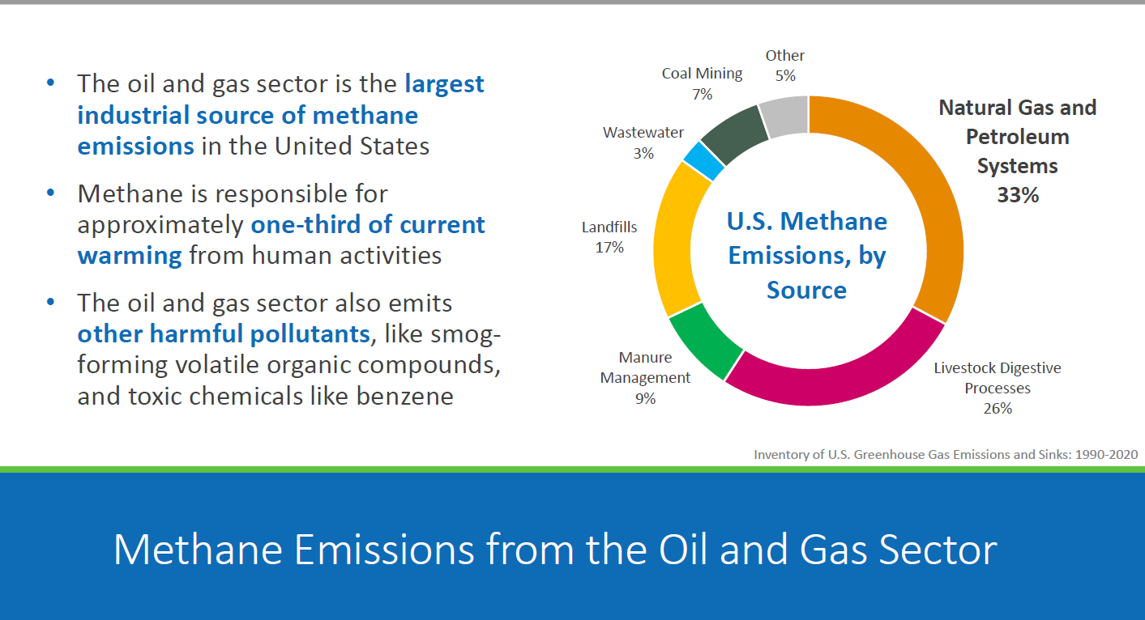
METHANE – Supplemental Proposal- Oil and Natural Gas Sector: 87 FR 74702 (Dec. 6, 2022)

Slide 11
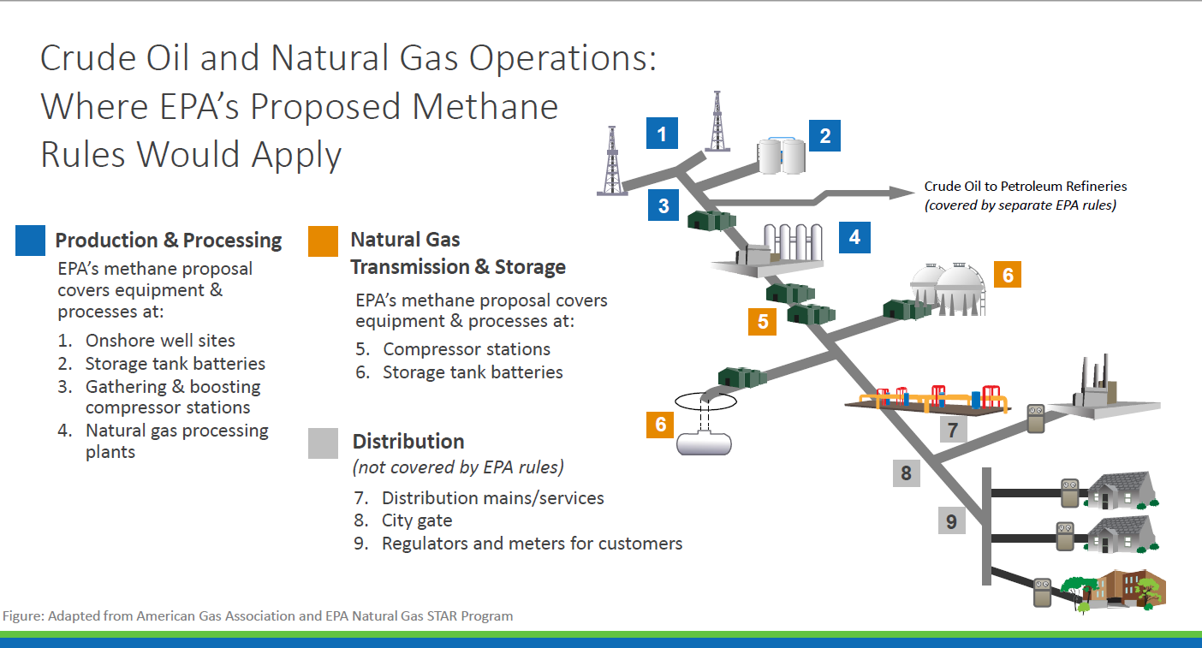
METHANE RULE: Addresses Interconnected System

Slide 12
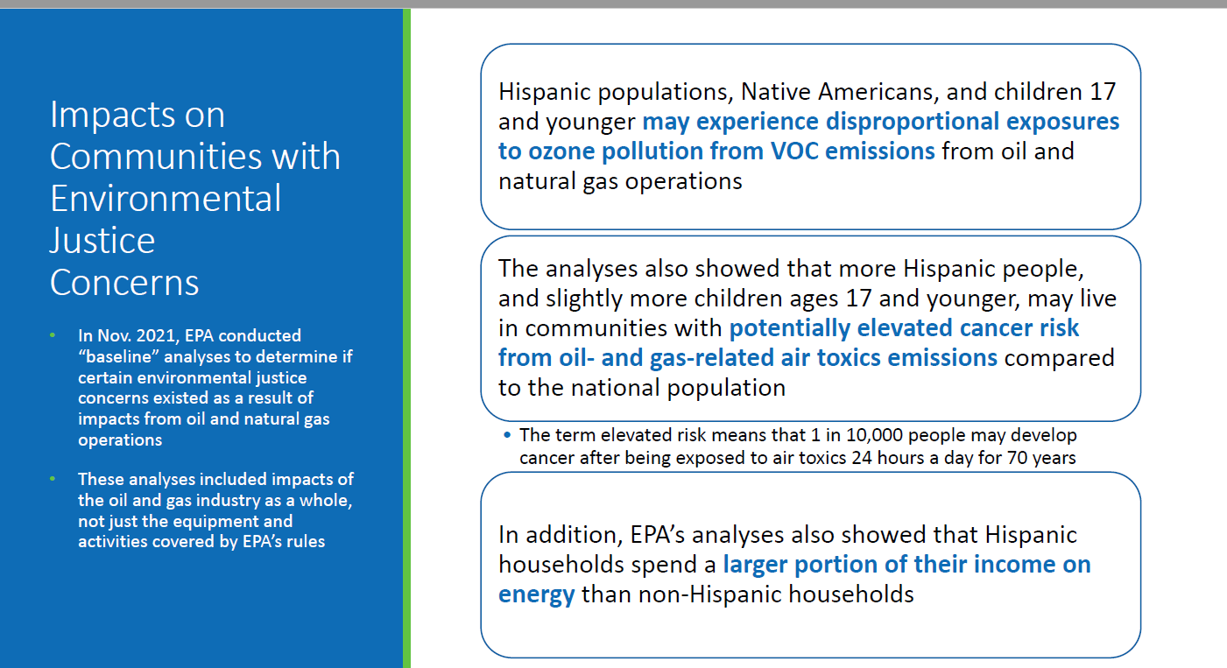
METHANE RULE: Environmental Justice Impacts

Slide 13
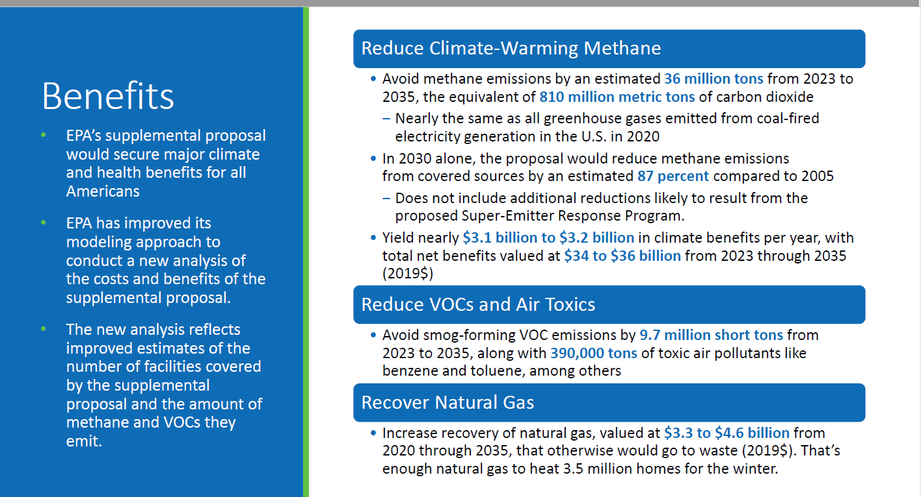
Methane RULE: BENEFITS

Slide 14
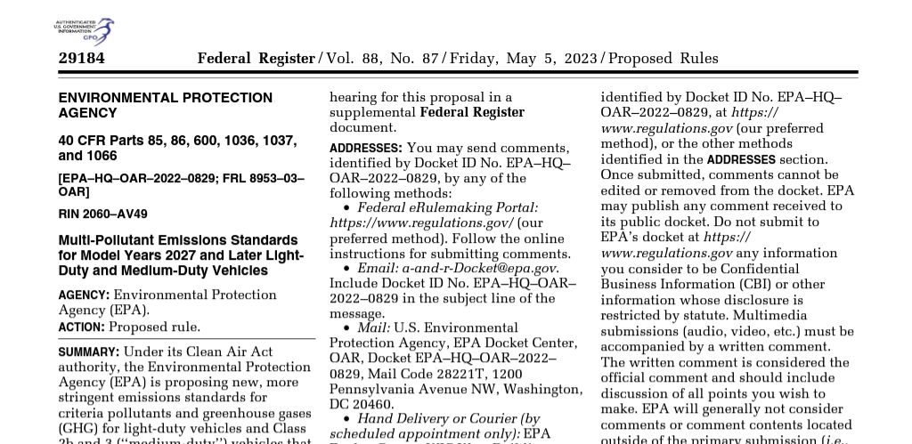
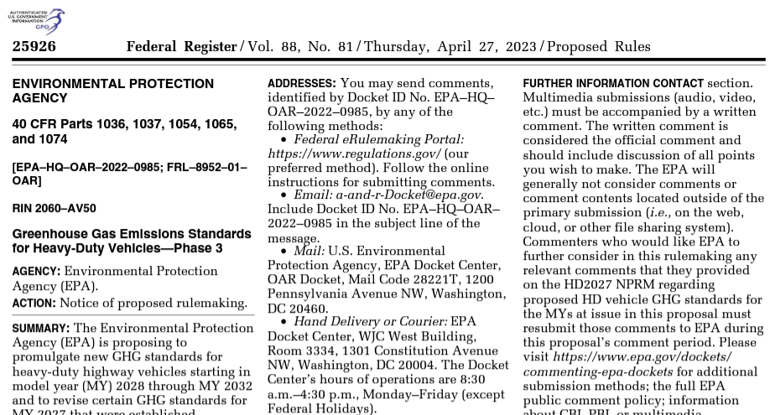
GHG Motor Vehicle Rules: Light/Medium Duty 88 FR 29184 (May 5, 2023); Heavy Duty 88 FR 25926 (April 27, 2023)

Slide 15
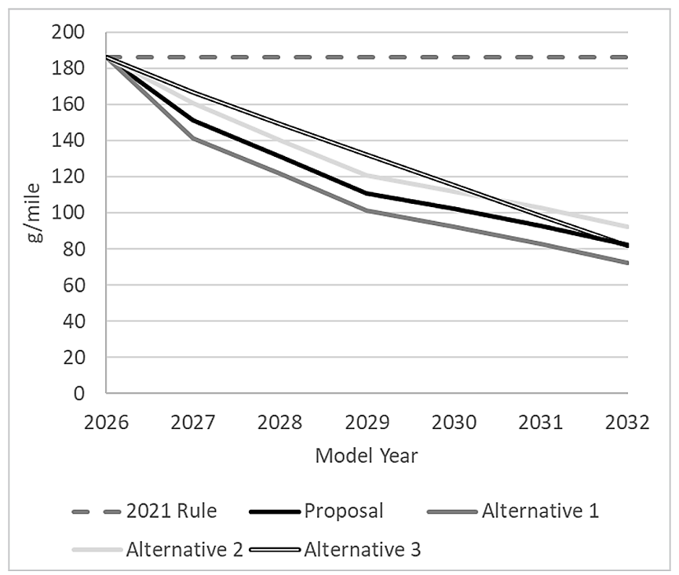
Projected Industry Fleet Average for Light Duty Vehicles g/mile compared to current MY 2026 standard (est. in 2021)

Slide 16
Light and Medium-Duty Vehicles: Proposed Rule for MY 2027-2032 (May 5, 2023)
Light Duty Vehicles: 56% Reduction in industry fleetwide average compared with 2026 by 2032
Medium Duty Vehicles: 44% Reduction in industry fleetwide average compared with 2026 by 2032
The vehicle technology costs of this proposal range from $180 billion to $280 billion, but the program also would have additional social benefits from fuel savings of $450 billion to $890 billion through 2055, and repair and maintenance savings (stemming from lower maintenance and repair of electric vehicles compared to gasoline vehicles) estimated through 2055 at $280 billion to $580 billion.

Slide 17
Heavy-Duty Vehicles: Proposed Rule for MY 2027-2032 (April 27, 2023)
Standards differentiated by vehicle type and use
Allows averaging, banking and trading
Avoid approximately 1.8 billion metric tons of greenhouse gas emissions from 2027 through 2055
EPA estimates that the total benefits of this proposal far exceed the total costs, by as much as $320 billion.
Society would realize approximately $87 billion in climate benefits and up to $29 billion in benefits from fewer premature death and serious health effects such as hospital admissions due to respiratory and cardiovascular illnesses, and approximately $12 billion in reduced reliance on oil imports.

Slide 18
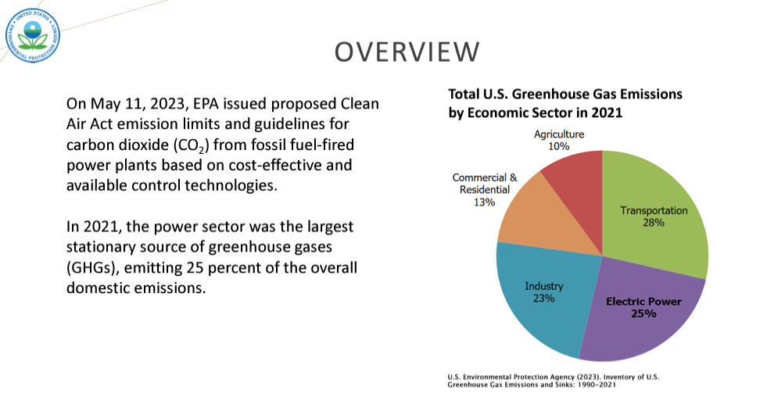
POWER SECTOR- Proposed Rule (not yet published)

Slide 19
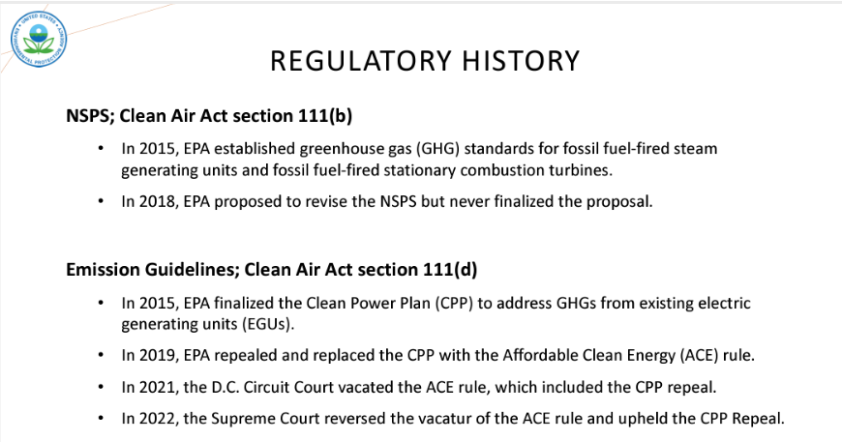
POWER SECTOR: CLEAN AIR ACT Section 111

Slide 20
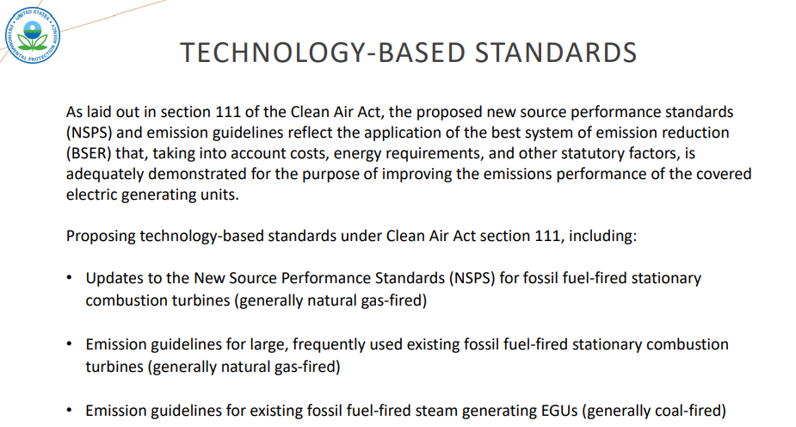
POWER SECTOR – STANDARDS

Slide 21
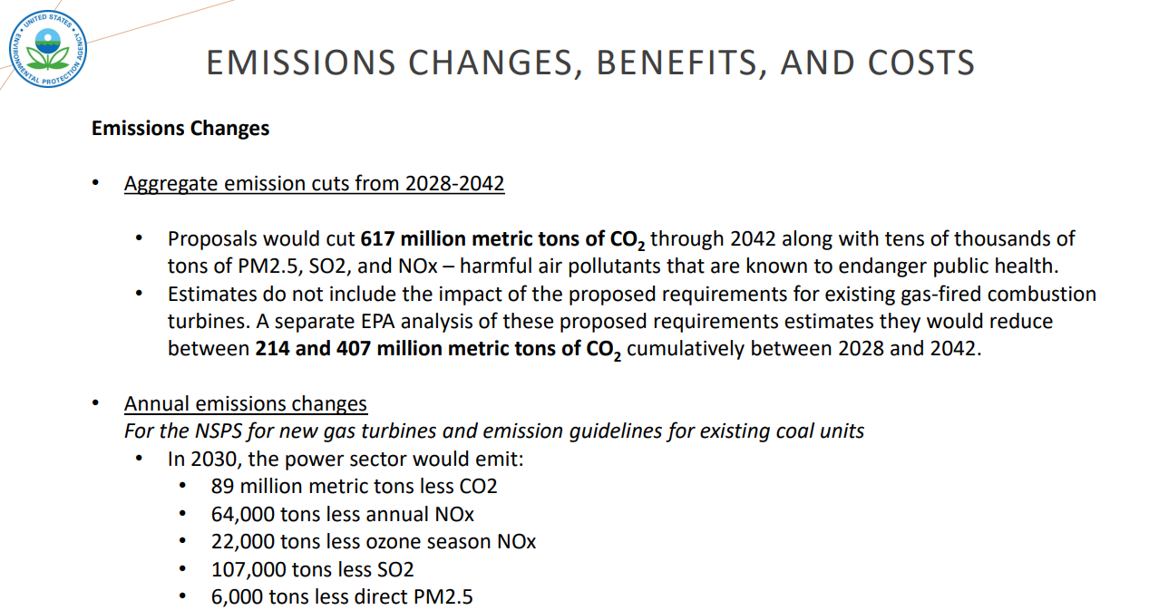
POWER SECTOR – Benefits/Costs

Slide 22
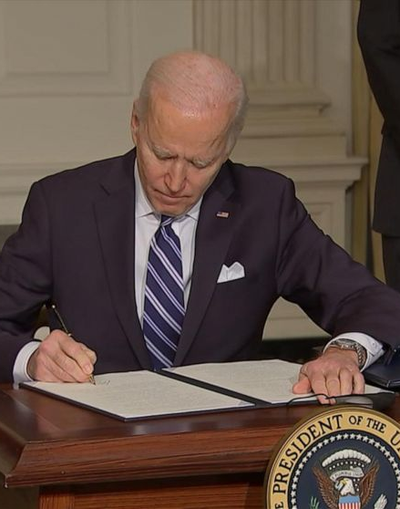
ADAPTATION
E.O. 14008 on Tackling the Climate Crisis at Home and Abroad, Section 211 (Jan. 27, 2021)
“The head of each agency shall submit a draft action plan… within 120 days of the date of this order that describes steps the agency can take with regard to its facilities and operations to bolster adaptation and increase resilience to the impacts of climate change.”

Slide 23
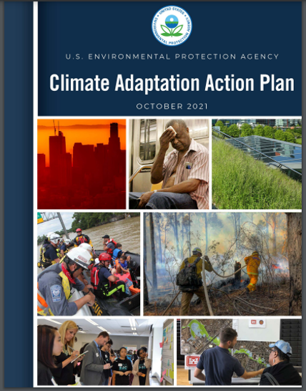
DIRECTS EPA REGIONAL OFFICES TO UPDATE THEIR 2014 ADAPTATION PLANS

Slide 24
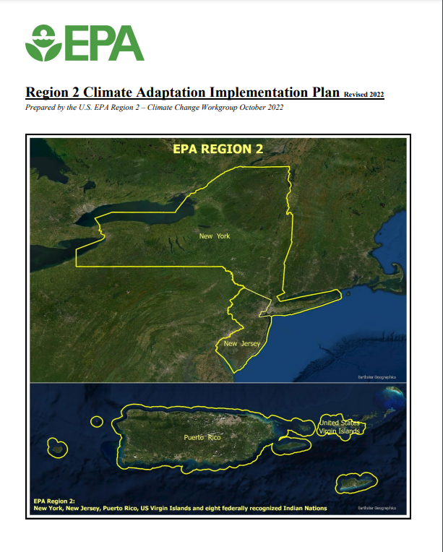
Released Oct. 6, 2022

Slide 25
Adaptation Plan – Overview
Vulnerability Assessment
Regional vulnerabilities (e.g., rising seas, high temperatures, tidal flooding)
Programmatic vulnerabilities (e.g., Air Quality; Water Quality; Contaminated Sites; Use and Exposure to Toxic Chemicals; EPA’s Facilities and Operations)
44 Regional Priority Actions
Reduce Impacts/Adapt to the identified programmatic vulnerabilities
Categorized into six thematic areas
Majority require additional resources
Training EPA Staff
Science Needs - to better inform climate change adaptation efforts

Slide 26
What’s New In The Vulnerability Assessment?
Updated science from 2014
Increased emphasis on vulnerable populations
New subsection specific to Puerto Rico and the USVI, including impacts of Hurricanes Maria and Irma
Updated observations from Indian Nation partners
New subsection on Trauma/Mental health
New subsection on conflict

Slide 27
Priority Actions: 6 THEMES
(1) Advance Research, Systems and Guidance that Support Climate Adaptation in Region 2
(2) Leverage Partnerships & Conduct Outreach to Enhance Adaptative Capacity in Region 2
(3) Seek Opportunities to Integrate Environmental Justice into Each of Our Climate Change Priority Actions, to the Extent Practicable
(4) Support the Use of Disaster Recovery Resources and Disaster Mitigation Strategies to Assist States, Local Communities, Indian Nations, and Territories in their Adaptation Efforts
(5) Use our Regulatory Authorities to Expand our Work on Climate Adaptation
(6) Maintaining Region 2 Facilities and Operations

Slide 28
THANK YOU!
Joe Siegel
Siegel.joseph@epa.gov

